Slide 1

AIML Group Lab Team 1 – AIML Jedi
Agricultural Price Forecasting

Slide 2
Agenda
Problem Statement
Introduction to Team
Data
Pre-processing
Algorithms
Expected End Results
Business Applications, Post course
Q & A

Slide 3
Problem Statement
Agricultural Price Forecasting using Neural Network
Historically, agriculture prices forecasting is done using Statistical methods like ARIMA which provides low accuracy
We can increase prediction accuracy by using Artificial Neural Network and Hybrid models

Slide 4


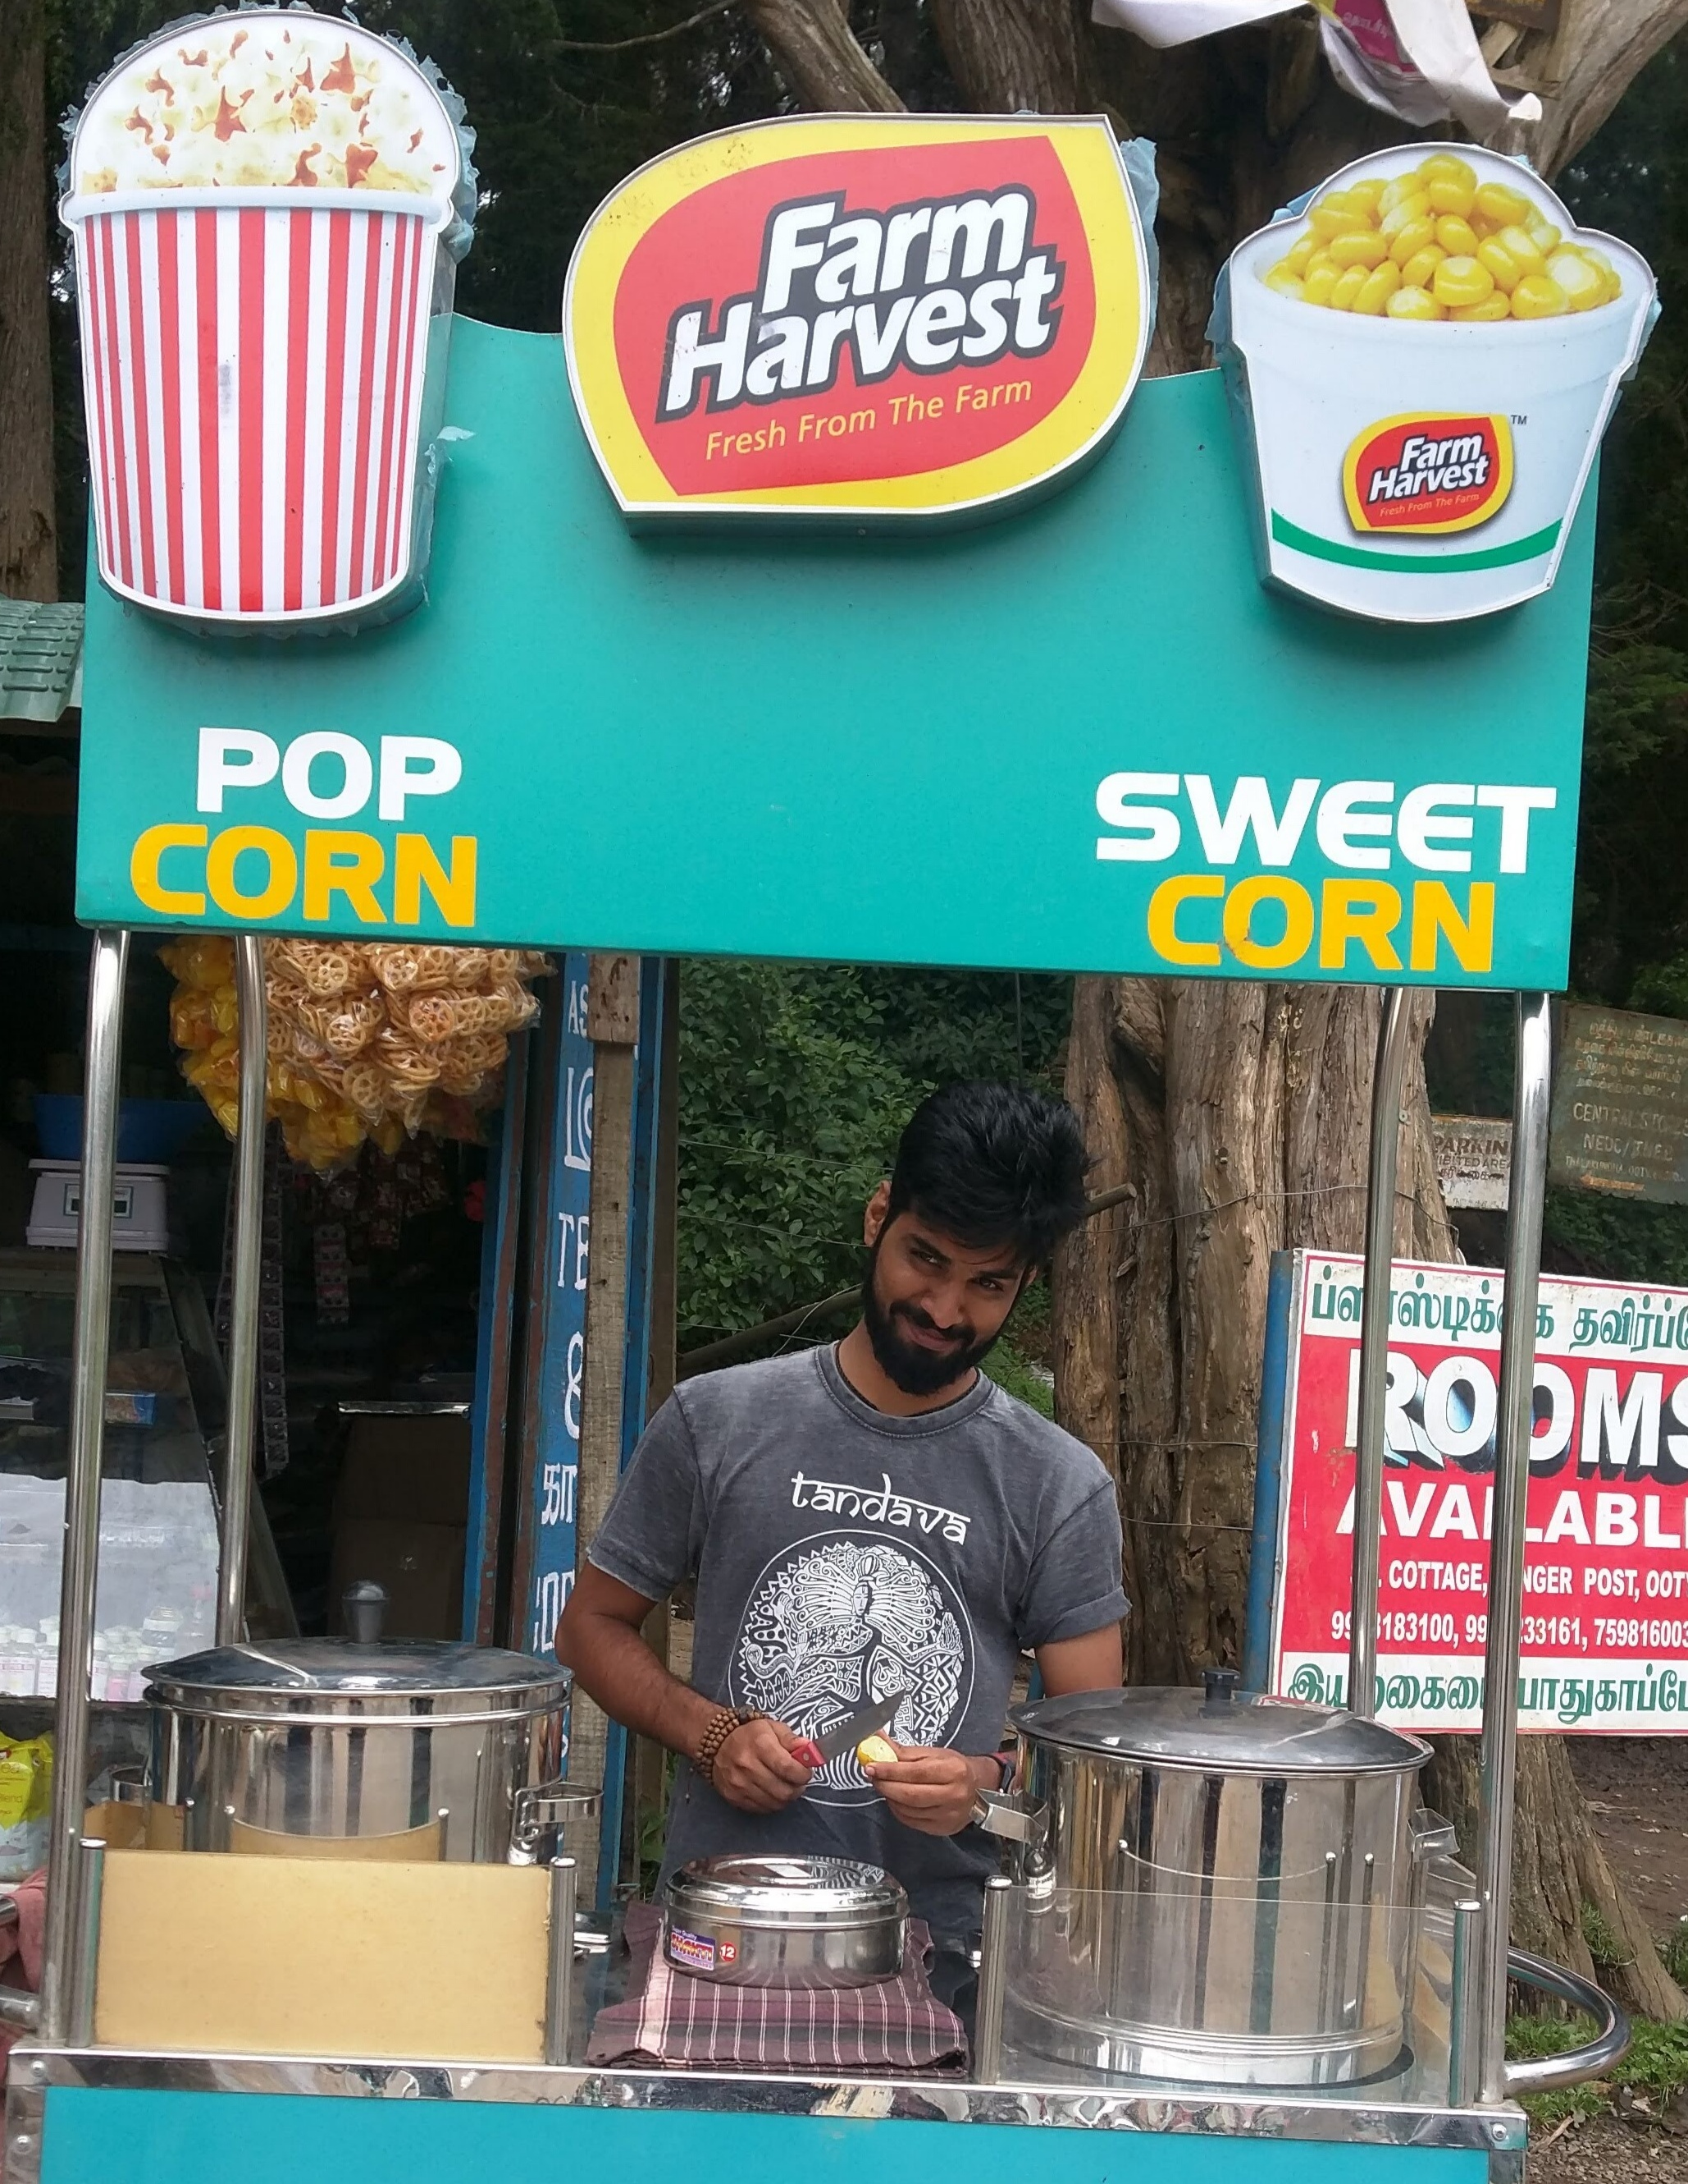


Team
Niveditha
Swati
Chetan
Lovekesh
Prasanna

Slide 5
Data
We chose this dataset because
Better pricing forecast can help farmers, policy makers and agribusinesses
Historical data available through multiple sources
  Wholesale and Retail pricing data
    Data Gov (https://data.gov.in/search/site?query=statewise+crop+price)
    Krishi Marata Vahini (https://www.krishimaratavahini.kar.nic.in/)
  Minimum Support Price
    Data Gov (https://data.gov.in/resources/crop-wise-difference-between-market-price-and-cost-production-and-minimum-support-prices)
    NABARD (https://www.nabard.org/casestudies-search.aspx?cid=509&AID=6&Key=crop+price)
High growth potential in terms of number of users and service categories

Slide 6
Data Pre-processing
Steps followed for processing the data:
Data Cleaning
  Handle Missing and Noisy Data
  Detect and Remove Outliers
Data Integration
  Combine data from multiple data sources
Data Transformation
  Normalization: Z-score normalization, tanh estimators
Data Reduction
  t-SNE, ISOMAP

Slide 7
Algorithms
Price Series
ARIMA
Hybrid solutions using ARIMA and LSTM
ARIMA is used to process linear data
LSTM is used to process non linear data if there are any
Performance measure
  Root Mean Square Error (RMSE)
  Mean Absolute Deviation (MAD)
  Accuracy
Nonlinearity Test
+ -
Residual
LSTM
+
Price Forecasts

Slide 8
Expected End Results
Better accuracy in agricultural price prediction
Better value for farmers and agribusiness industry through price recommendations
More reliable Decision Support System for policy makers

Slide 9
Post Course
Plans to implement or take this forward after the course
Develop and deploy the price forecasting system
Extend the pricing prediction to additional agricultural products (Initially considering 3 products: Rice, Wheat and Ragi)
Extend the model to include the impact of variable factors like cost of produciton, changes in input prices, weather/rain impact, domestic production, demand and supply, effect on cost of living and so on.
Make the price predictions easily accessible to users through mobile applications and web sites

Slide 10

Q & A

Slide 11

Thank you!
Do what you can,
With what you have,
Where you are
- Theodore Roosevelt
AIML Jedi

